Slide 1
COVID-19 Management: Preparation & Response
Mayuresh Hooli
Mason Jerome

Slide 2
COVID-19
COVID-19 is the deadliest pandemic since the Spanish Flu from over 100 years ago
Suppliers are short on medical supplies
The best way to allocate resources and mitigate spread of COVID-19 needs to be identified
The COVID-19 Management System can help with this

Slide 3
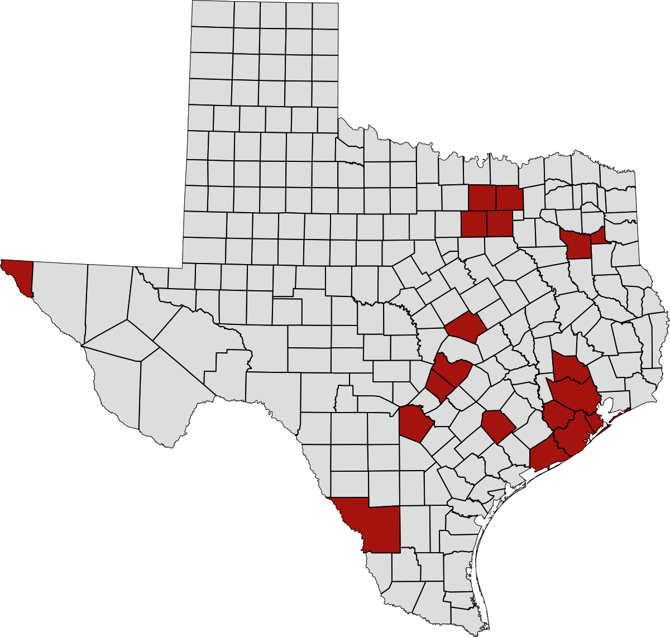
What does it do?
COVID-19 Management System is an intelligent system that identifies the critical areas (case study: Texas) where actions need to be taken
This system ranks counties based on the risk they pose of spreading the virus to neighboring counties

Slide 4
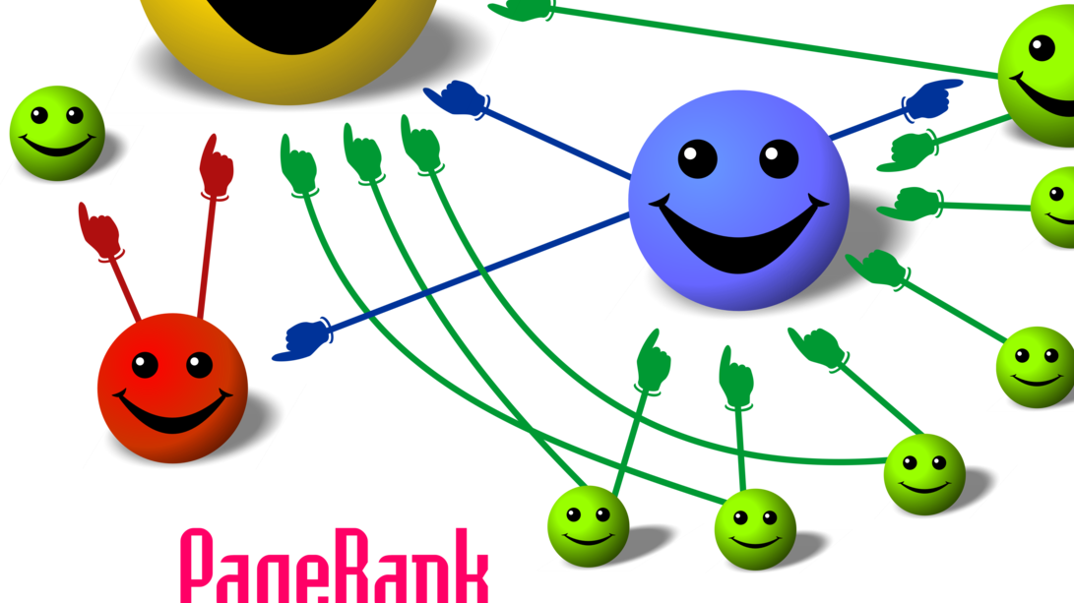
How is this done?
This idea implements clustering along with the PageRank algorithm
Clustering identifies 4 clusters based on the dataset we prepared
PageRank uses the clustering prediction to identify which counties risk spreading the virus further

Slide 5
Why is this done?
There is a shortage of medical personnel and testing kits across the country
The categorization of counties helps in effective allocation of resources
The prediction of how counties will be affected in the future leads to better preparedness to mitigate the virus

Slide 6
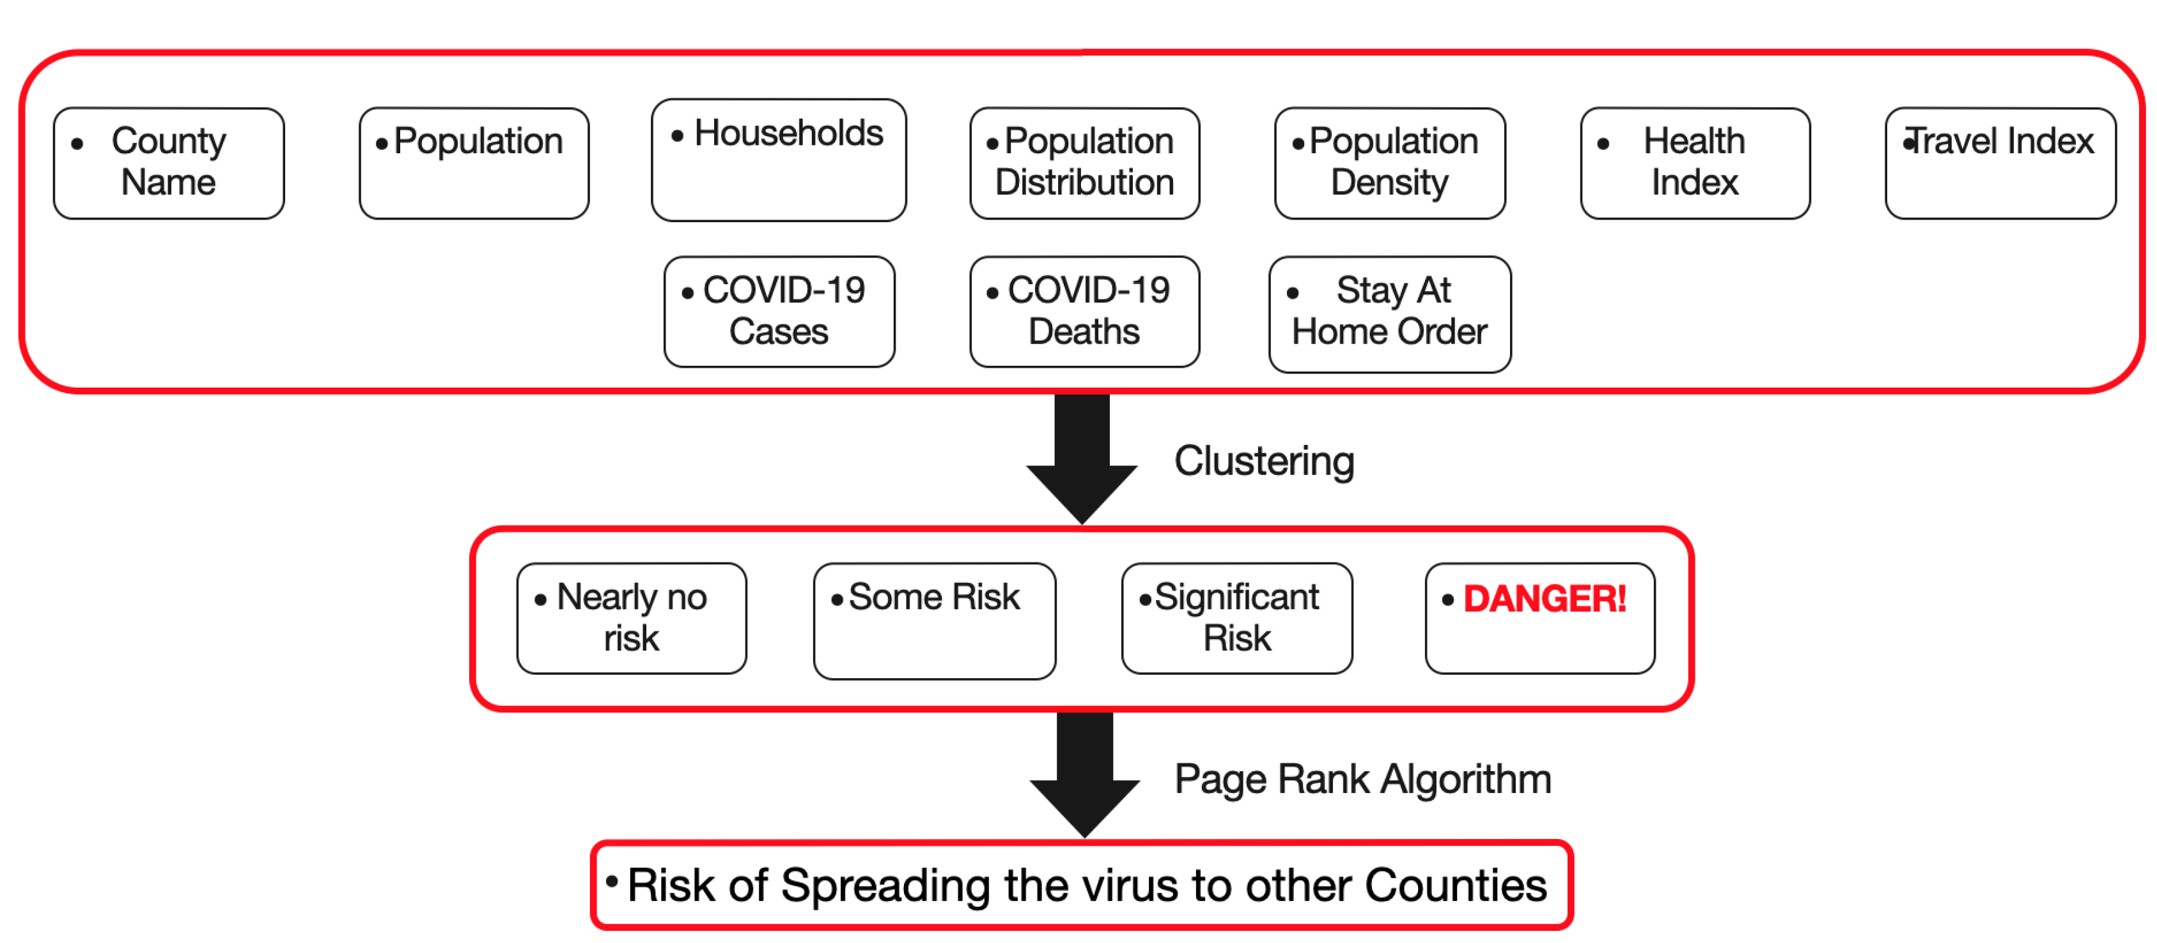
Diagram of code

Slide 7
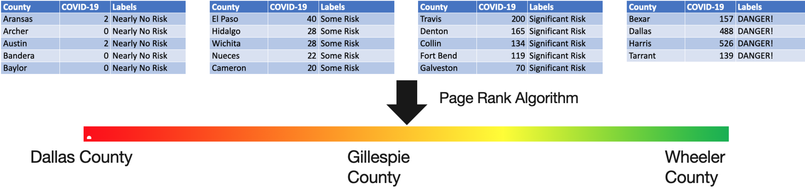
Results

Slide 8

Novelty
Everyone around the world is trying to figure out a way to combat the pandemic
The novel approach of using Clustering and PageRank together would help us understand where the risk lies
The results obtained from this algorithm would help us in the fight against the COVID-19 pandemic

Slide 9
Future Work
Extend the algorithm to the whole country by collecting data from all counties
Use GIS to identify zones on the map for better visualization
Collect more relevant parameters to identify the spread of virus
Create a similar model for pandemic response and disaster response to help manage similar situations in the future
Help humanity

Slide 10
Thank You!

